Slide 1



Slide 2

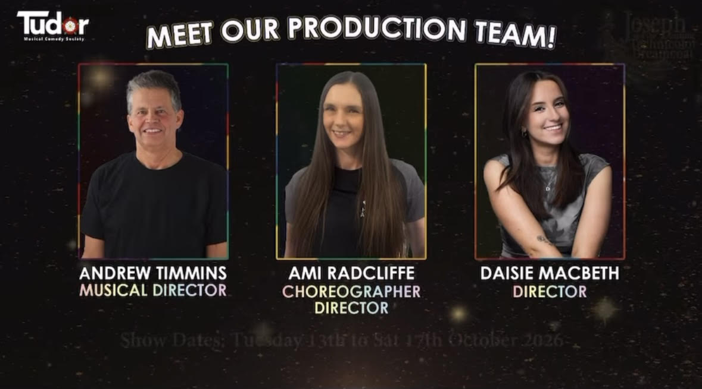
Ｍｅｅｔ ｙｏｕｒ ｃｒｅａｔｉｖｅ ｔｅａｍ
Andrew Timmins
Musical Director
Ami Radcliffe
Choreographer
Director
Daisie Macbeth
Director

Slide 3
𝓞𝓾𝓻 𝓥𝓲𝓼𝓲𝓸𝓷
Our vision for Joseph and the Amazing Technicolor Dreamcoat is inspired by the wonderful world of colour — bold, vibrant, joyful, and full of life. Colour is at the heart of this show: not just in Joseph’s coat, but in every emotion, relationship, and journey each character experiences.
We plan to bring this story to life with a talented children’s cast, transporting young performers — and our audiences — into a world that explores family dynamics, jealousy, dreams, resilience, and ultimately forgiveness. Through energetic storytelling, infectious music, and imaginative staging, we will create a playful yet powerful production that allows children to step into big themes with honesty and heart.
This is more than a musical; it is a story about belonging. It shows how jealousy can divide us, how hardship can shape us, and how forgiveness can heal and reunite. In a world where families and communities face challenges every day, Joseph’s journey feels more relevant than ever.
Our production will celebrate the power of family in all its complexity, leaving audiences feeling warm, uplifted, and just a little bit brighter — wrapped in colour, hope, and the magic of storytelling.

Slide 4
Joseph takes us into a world of huge personalities, stylised comic caricatures that are larger than life. It tickles panto! A monochrome world at first, becomes relatable themes on a rainbow proportion! It we are not having a party by the megamix we haven’t got it right!

Slide 5
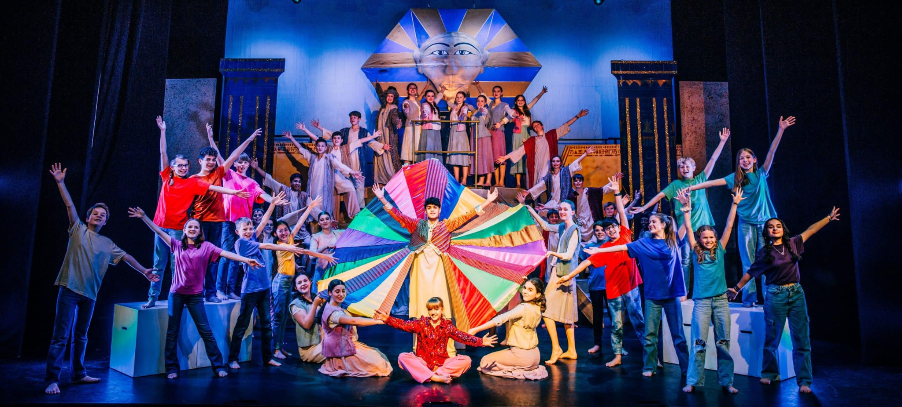
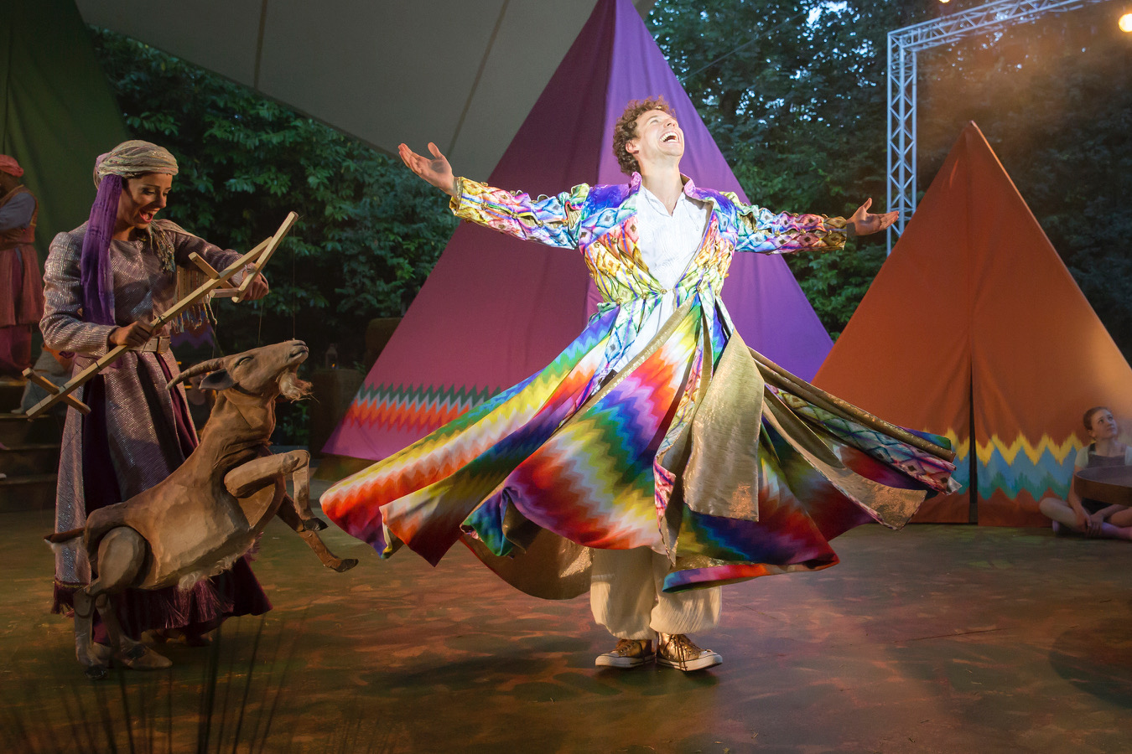
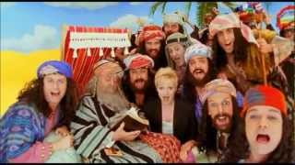
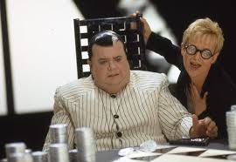
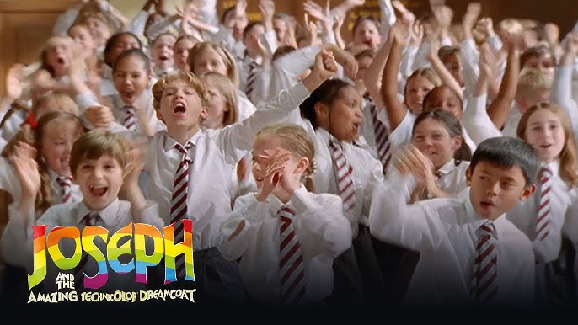
Ⓢⓨⓝⓞⓟⓢⓘⓢ
Joseph, the favourite son of Jacob, is given a dazzling technicolour dream coat. This makes his 11 brothers insanely jealous.
Because of this, the brothers sell Joseph into slavery in Egypt, and convince Jacob that Joseph has passed away
The story opens in a school setting, where the children are being told the biblical story of Joseph. As the Narrator continues the story, we are transported into the world of Joseph…
Joseph shares prophetic dreams that one day suggest that he will rule over his family, worsening his brothers anger.
Joseph is bought by Potiphar, an Egyptian official, and quickly rises in importance.

Slide 6
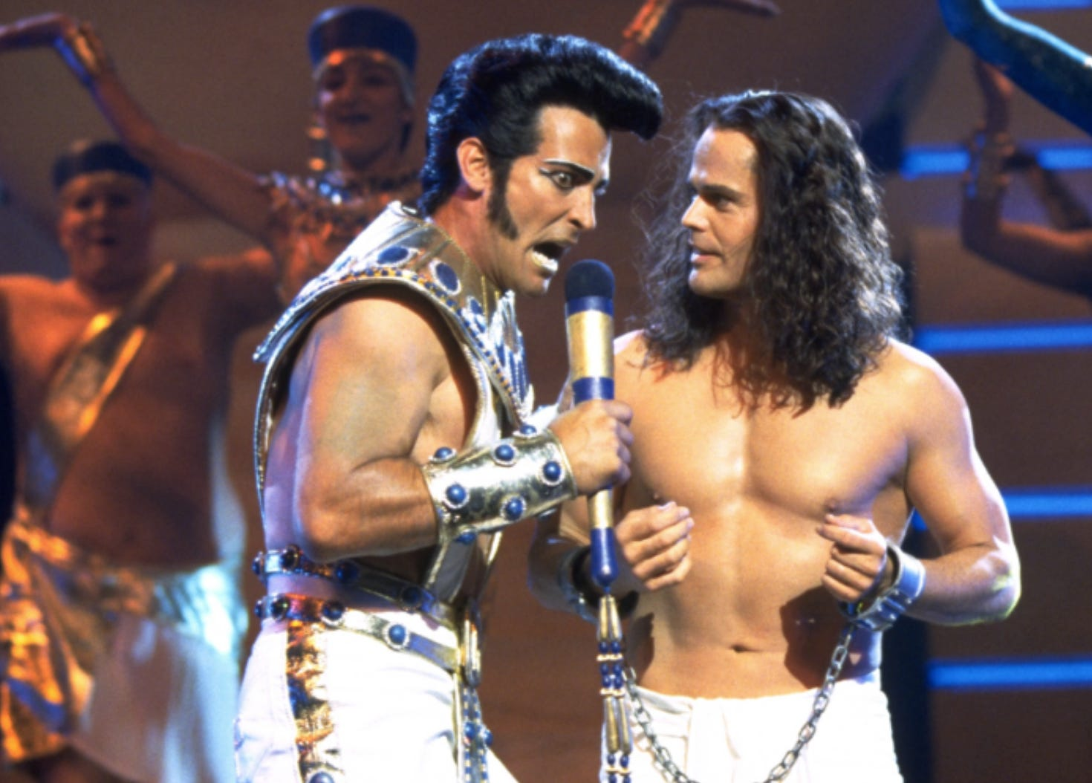
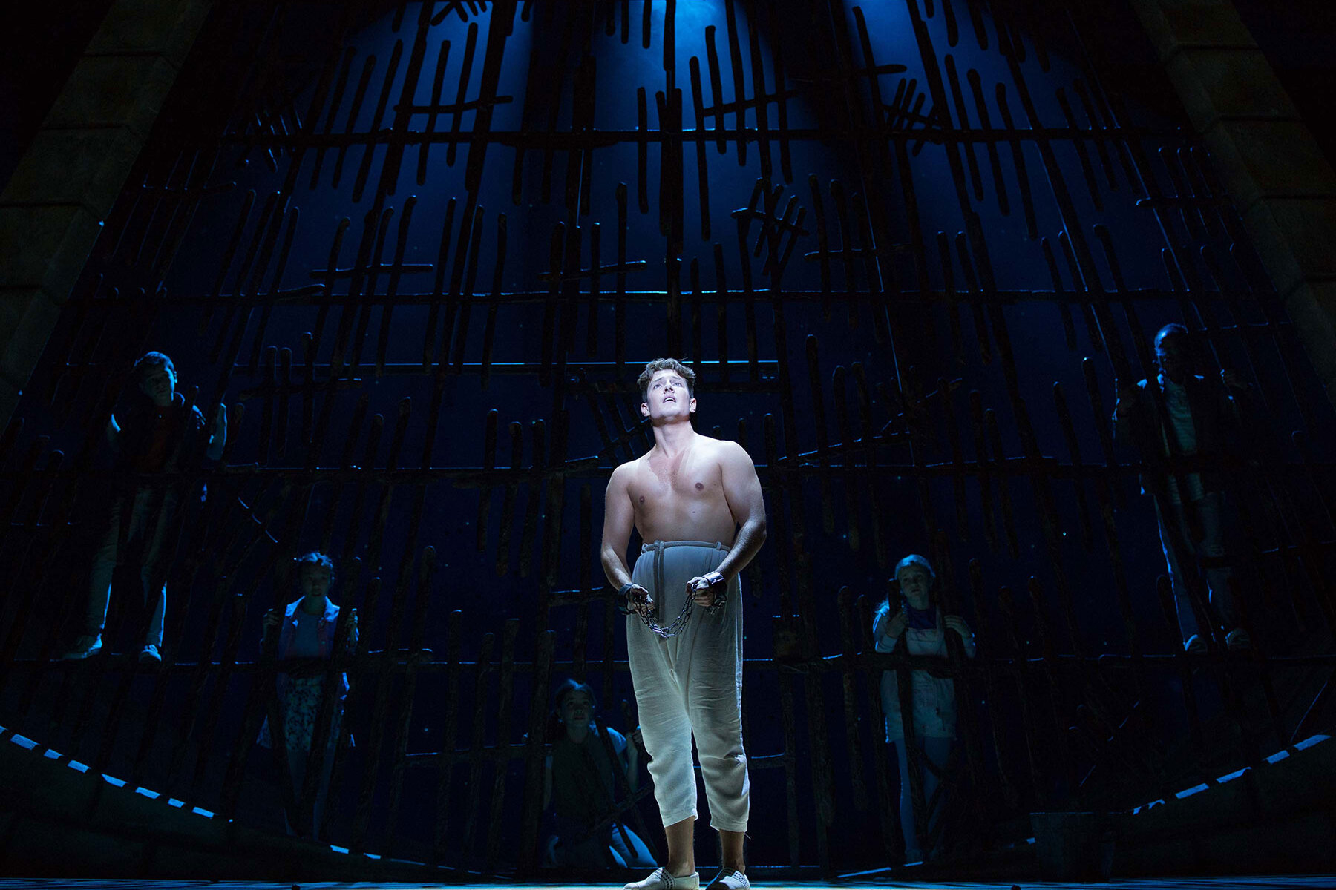
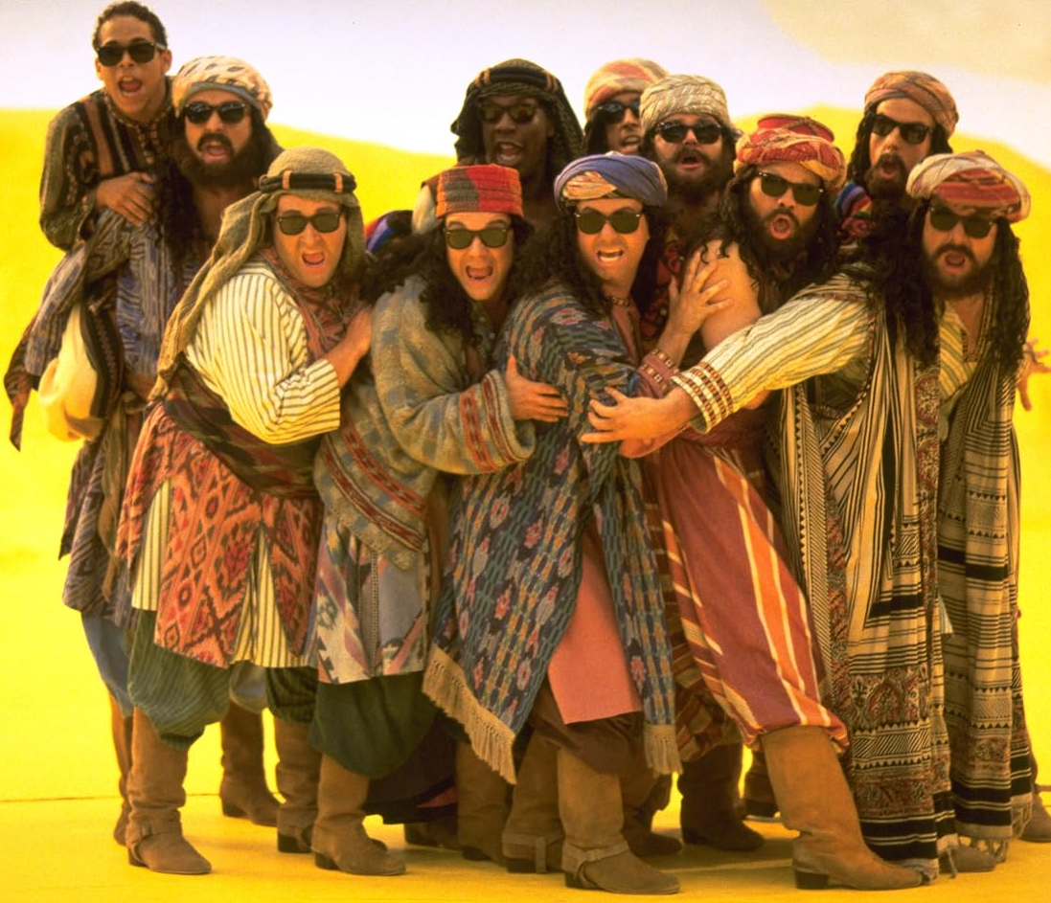
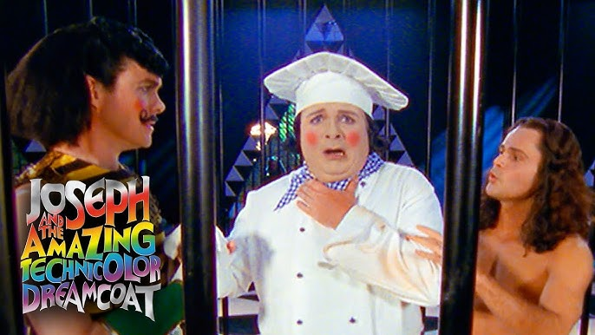
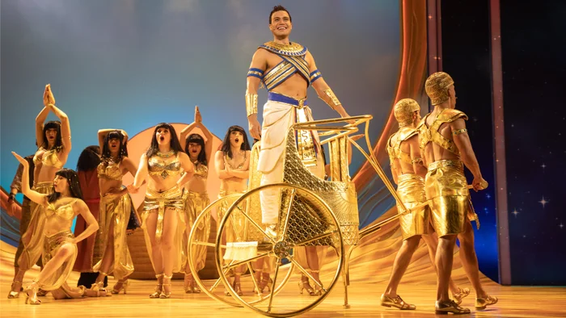
Ⓢⓨⓝⓞⓟⓢⓘⓢ
After being falsely accused by Potiphar’s wife, Joseph is sent to prison
Joseph is brought before Pharaoh to interpret his troubling dreams, foretelling seven years of plenty followed by seven years of famine.
During the famine, Joseph’s brothers travel to Egypt for food and fail to recognize him
Pharaoh appoints Joseph second-in-command of Egypt, placing him in charge of food supplies.
In prison, Joseph successfully interprets dreams, showing his special gift

Slide 7
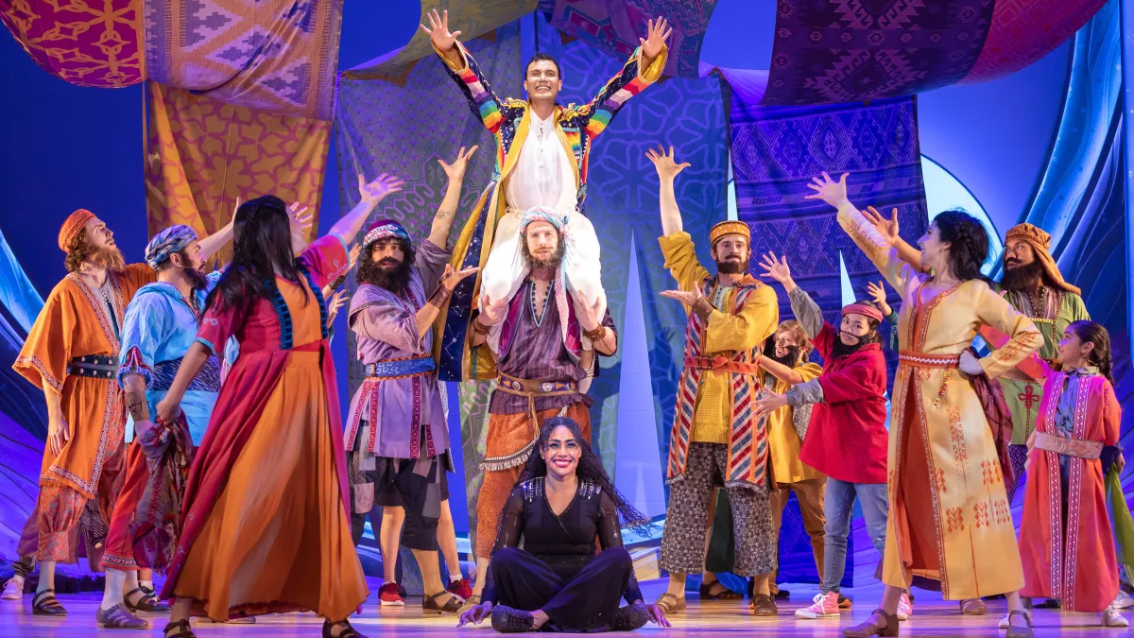
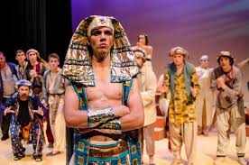
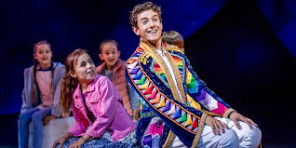
Ⓢⓨⓝⓞⓟⓢⓘⓢ
Joseph forgives his brothers, reunites with his family, and brings them to live safely in Egypt
𝓣𝓱𝓮 𝓔𝓷𝓭
Joseph tests their loyalty and compassion before revealing his identity.
The story ends as the children and Narrator celebrate forgiveness, hope, and imagination, returning to the school setting.

Slide 8
𝓒𝓱𝓪𝓻𝓪𝓬𝓽𝓮𝓻𝓼
In Joseph and his Amazing Technicolor Dreamcoat, there are so many different characters that make up the show! We will be auditioning for the following roles.
𝙹𝚘𝚜𝚎𝚙𝚑
𝙽𝚊𝚛𝚛𝚊𝚝𝚘𝚛
𝙹𝚊𝚌𝚘𝚋
Joseph is the hero of the story. He is kind, confident, and optimistic, having the special gift of interpreting dreams. This makes him his father’s favorite son, but also causes trouble and jealousy amongst his brothers. Even when betrayed and treated unfairly, Joseph stays hopeful and eventually rises to power through his intelligence and forgiveness. Jospeh is earnest and emotionally open, strong storyteller.
(approx age 17-25)
The Narrator is the storyteller who guides the audience through the show. The Narrator is calm, clear, and supportive, often explaining the action and emotions of the story. They act as a bridge between the audience and the characters, interacting directly with both. Must be able to interact with the childrens cast, confident and commanding.
Jacob is Joseph’s father. He is loving father but flawed, as he clearly favors Joseph over his other sons. His gift of the colorful coat sparks jealousy among the brothers, acting as a catalyst for Joseph’s journey. Jacob is emotional and dramatic, especially when he believes Joseph is dead. He has a warm, dignified and gentle prensence.
(Age range 60+ looking)

Slide 9
𝓒𝓱𝓪𝓻𝓪𝓬𝓽𝓮𝓻𝓼
𝙿𝚘𝚝𝚒𝚙𝚑𝚊𝚛
𝙼𝚛𝚜. 𝙿𝚘𝚝𝚒𝚙𝚑𝚊𝚛
𝙿𝚑𝚊𝚛𝚊𝚘𝚑
A wealthy Egyptian official who buys Joseph as a slave. Potiphar is powerful, confident, and often portrayed humorously as stiff or oblivious. He promotes Joseph because of his success and reliability, before sending him to prison. Comic authority needed, exaggerated upper-class.
Potiphar’s flirtatious and dramatic wife. She aggressively pursues Joseph and becomes angry when he rejects her. Her false accusation sends Joseph to prison. She’s often played for comedy and exaggerated glamour. Sultry, comic seductress, physical comedy.
The ruler of Egypt. Pharaoh is over-the-top, stylish, and often portrayed like a pop star, famously Elvis-inspired. Though powerful, he is deeply troubled by his dreams and relies on Joseph to interpret them. He rewards Joseph with authority and wealth. Big personality with swagger!

Slide 10
𝓒𝓱𝓪𝓻𝓪𝓬𝓽𝓮𝓻𝓼
The Butler
The Baker
Adult Ensemble
A servant of Pharaoh who is imprisoned with Joseph. He is anxious and polite. After Joseph correctly interprets his dream, the Butler is restored to his position, for the time being.
Another servant imprisoned with Joseph. The Baker is more arrogant and gloomy. Joseph’s interpretation of his dream predicts his execution, which sadly comes true.
These characters help create the world of the story, playing townspeople, servants, Egyptians, dancers, and more. They often shift roles and styles throughout the show, adding energy, humor, and spectacle.

Slide 11
𝓒𝓱𝓪𝓻𝓪𝓬𝓽𝓮𝓻𝓼
𝚃𝚑𝚎 𝙱𝚛𝚘𝚝𝚑𝚎𝚛𝚜
Joseph’s older brothers are jealous, bitter, and easily influenced by group thinking. While they each have distinct personalities, often shown humorously in song, together they act as antagonists. Over time, they regret their actions and seek forgiveness.
Age range 13-40 years old
𝚁𝚎𝚞𝚋𝚎𝚗 - Oldest brother who tries to responsible but lacks authority. He often feels quite guilty about what happens to Joseph, and wants to avoid violence. Big headed, slightly anxious leader.
𝚂𝚒𝚖𝚎𝚘𝚗 - He is very hot - headed, and can be quite angry and impulsive. He is quick to turn against Joseph, and is often portrayed as one of the meaner brothers. Tough and aggressive, comic villian.
𝙻𝚎𝚟𝚒 - Levis is very cruel and sarcastic, coming across as quite intimidating. Frequently backing Simeon, adding verbal cruelty to the bullying. Smooth, sly French-cabaret flair.
Judah - He is a confident Leader, who is persuasive, bold and charismatic. He suggests selling Joseph instead of killing him. Confident, serious, emotional weight amongst his brothers.
𝙳𝚊𝚗 - Dan is a sneaky schemer, who enjoys plotting and stirring trouble behind the scenes.
𝙽𝚊𝚙𝚑𝚝𝚊𝚕𝚒 - The athlete of the group. An energetic, competitive, show off, who is often portrayed as sporty and physical.
𝙶𝚊𝚍 - The tough brother, who uses his physical presence more than words.
𝙰𝚜𝚑𝚎𝚛 - Is the smooth and relaxed brother, who can be quite flirtatious. He can be seen as self absorbed.
𝙸𝚜𝚜𝚊𝚌𝚑𝚊𝚛 - Issachar is a worrier, who is very intellectual and thoughtful. He questions the plan but never stops it.
𝚉𝚎𝚋𝚞𝚕𝚞𝚗 - The comedian of the group. Who is loud, silly and easily influenced, seeking his brothers approval.
𝙱𝚎𝚗𝚓𝚊𝚖𝚒𝚗 - The youngest and most innocent of the brothers. He is Kind Gentle and Loyal, he is usually separated from the cruelty.

Slide 12
We will consider any age and any gender for roles within this show, with a few exceptions! The age range and gender of Joseph and Jacob must make sense, and the age range of the brothers too, but we will consider females playing the role of a brother. It’s the story and the message that’s important in a show like this. Have fun with these characters, we are looking forward to seeing what you bring to auditions! We are open to considering the role of Narrator as a shared part, this could be really exciting to explore the different sides of the Narrator so there’s everything to play for! Finding your role within the Ensemble will happen during our workshop one and three. There are opportunities within the ensemble for smaller roles, some with a more dance focus and other more singing with movement. You can decide if you want a dance focus and/or a singing/acting focus. We don’t expect you to be word perfect in an audition so long as you know the audition piece well enough to not be hindered by a script, you can have it if you need on the 22nd.
Our vision for the casting!

Slide 13
Casting the Brothers!
Casting soloist Brothers will happen on the Audition Day 22nd March.
Casting the none soloist Brothers will happen during the Brothers Workshop (workshop 2). During this session we will learn a scene and you will be given the opportunity to sing as a soloist, if you want to. You do not need to prepare for this workshop, during which you can let us know which Brother you would like to play.
If there are multiple people interested in a none singing Brothers role, we will give a fair opportunity during the workshops, this may include going away to learn a section of song for workshop 3 if very competitive.
Humour and comic timing essential for the collective roles of the Brothers. If you audition for a singing Brother and its competitive, you will definitely be considered for another brother, and it would be helpful if you could attend the Brothers workshop too.

Slide 14
🅺🅴🆈 🅳🅰🆃🅴🆂
Audition Prep & Workshops - Thursday 5th, 12th, 19th March 7:30 – 9.30pm @ Stonnall
Audition Day - Sunday 22nd March 11:30am onward @ Cooper Room – Once you have all expressed your audition interest, a schedule for the audition day will be communicated.
Rehearsals - Thursdays 7:30pm - 10:00pm @ Stonnall - Adults Only (beginning 16th April) Sundays @ Cooper Room – Children Only (beginning 26th April). Adults will join Sunday rehearsals from 6th September. Children will join Thursday rehearsals from June.
Childrens Workshop audition - Sunday 19th April 2:00pm - 3:30pm @ Cooper Room. All children who attend this day will be invited to be part of our Childrens cast, depending on interest we may have two casts, more information will follow depending on sign up.
Sunday October 4th - All day rehearsals with both adult and children’s cast @ Cooper room
Thursday October 8th - Rehearsal with both adult and children’s cast (7.30pm-10.00) @ Stonnall
Saturday October 11th – TBC, keep this date just incase.
Sunday October 12th – Get in at The Town Hall!!. Band Call 10 am, all times will be confirmed nearer the time, expect to be needed all day.
Monday October 13th – Full Dress Rehearsal. All times will be confirmed nearer the time.
Show Week - Tuesday 13th - Saturday 17th October! All times will be confirmed nearer the time.

Slide 15
What are we doing in our workshops?
Before we hold our auditions we have 3 workshops to help prepare you in the best way possible. These workshops will also be our ensemble relaxed auditions, a chance for you to show us what you can do and learn your audition parts!
𝚆𝚘𝚛𝚔𝚜𝚑𝚘𝚙 1
Thursday 5th March
𝚆𝚘𝚛𝚔𝚜𝚑𝚘𝚙 2
Thursday 12th March
𝚆𝚘𝚛𝚔𝚜𝚑𝚘𝚙 3
Thursday 19th March
Brother movement and character workshop, Benjamin Calypso.
Anyone who would like to audition for Joseph/Narrator learn their audition sections.
Song of the Kings dance/movement workshop.
Anyone who would like to audition for Paraoh/Potiphar/Mrs Potiphar/Jacob learn their audition sections.
Go Go Go Joseph dance/movement workshop.
Anyone who would like to audition for Baker/Butler/Simeon/ Levi/Reuben/Judah will learn their audition sections.

Slide 16
Expectations!
This is the Full Fat version of Joseph. All the tricky bits are in including the Megamix!
One long sing! No gaps, no rest and no libretto. Full range particularly for Sopranos – top Cs!
Part singing and lots of it! Often 6 parts if we can manage it.
Whether you are principles, dancers, ensemble – there is no hiding from SINGING
Full Band as always. Probably one of the biggest we’ve had with a drummer in a shed!
Rehearsals – early ones be prepared to record parts on phones.
Individual practice between rehearsals is essential from all so we can move quickly.
Singing without books. You’ll need to learn parts and songs quickly so you can add movement etc.
Initially we will work through numbers in order.
First half of rehearsal evenings will likely be singing and second part will be setting to movement/dancing/acting.
Principals – sessions at Lichfield with me at times to suit midweek - as and when needed.
Rehearsal videos will be shared weekly

Slide 17
🄰🅄🄳🄸🅃🄸🄾🄽 🄸🄽🄵🄾🅁🄼🄰🅃🄸🄾🄽
Joseph - (High Tenor - D3 to C5) - Close every door – Bars 1-44
Narrator - (Mezzo-soprano - G3 - C6) - Prologue - Bars 1-20
Jacob and Sons – Bars 10-25 with repeat
Pharaoh - (High Baritone - B2 - G4) - Song of the Kings - Bars 1-77
Potiphar - (Baritone - B2 - E4) - Potipher – Bars 37-51
Mrs Potiphar - (Mezzo-Soprano - G3 - C5) Potiphar – Bars 52-67
Jacob - (Baritone - A2 - D4) - Josephs Coat – Bars 52-77
Baker - (Tenor if male, Alto if female) - Go, Go, Go, Joseph – Bars 27-40
Butler - (Baritone if male, Alto if female) - Go, Go, Go, Joseph – Bars 27-40

Slide 18
🄰🅄🄳🄸🅃🄸🄾🄽 🄸🄽🄵🄾🅁🄼🄰🅃🄸🄾🄽
We will be auditioning for the following Brothers roles on the 22nd March
Reuben - (Baritone - A2 - F4) - One More Angel - Bars 10-33
Judah - (Tenor - C3 - A4) - Benjamin Calypso – Bars 9-40
Simeon - (Baritone - A2 - E4) - Those Canaan Days – Bars 12-49
Levi (Tenor - C3 - G4) - Those Canaan Days - Bars 12-49
All other Brothers will be cast from the Brothers workshop on the 12th March.
Audition selection has been made to give you an opportunity to show us what you can do, the song/bars selected might not be what the exact part that you would do in the show, but this is what we would like to see.
If you are only wanting to be a part of the ensemble, you do not need to attend the audition on the 22nd.

Slide 19

So, you want to be part of this show!!!
You can use this form to
- register for an audition
register your child for the childrens workshop
- tell us in what capacity you’d like to join our ensemble
- tell us about planned holidays so we can finish the rehearsal schedule!
Paper sign up also available this evening!
Then its easy, just turn up to our workshops and find your place with us!
Please scan our QR Code and fill out the form to join our cast !

